Slide 1
AIR TICKET ANALYSIS
DATA SCIENCE AND FUNDAMENDALS PROJECT
Presented By:
D.S.MADHAN-KINGS COLLEGE-8211-CIVIL

Slide 2
OUTLINE
Problem Statement
Proposed System/Solution
System Development Approach
Algorithm & Deployment
Result
Conclusion
Future Scope
References

Slide 3
PROBLEM STATEMENT
"To analyze air ticket data to identify patterns, trends, and insights that can inform pricing strategies, route optimization, customer segmentation, and overall business decision-making for airlines and travel agencies. This analysis aims to maximize revenue, improve operational efficiency, enhance customer satisfaction, and stay competitive in the dynamic aviation industry."

Slide 4
PROPOSED SOLUTION
Data Collection: Gather comprehensive data on air ticket sales, including ticket prices, booking dates, departure and arrival locations, passenger demographics, travel dates, flight durations, and any other relevant information.
Data Cleaning and Preprocessing: Clean the dataset to remove any inconsistencies, errors, or missing values. Preprocess the data by standardizing formats, handling outliers, and encoding categorical variables.
Exploratory Data Analysis (EDA): Conduct exploratory data analysis to uncover patterns, correlations, and insights within the dataset. Visualize key metrics such as ticket prices over time, popular routes, peak travel periods, and customer preferences.
Feature Engineering: Extract relevant features from the data that can enhance predictive modeling and analysis. This may include creating new variables such as travel distance, flight duration categories, or customer loyalty status.
Predictive Modeling: Develop predictive models to forecast ticket demand, optimize pricing strategies, and predict customer behavior. Utilize machine learning algorithms such as regression, classification, or clustering to build accurate models based on historical data.
Performance Evaluation: Evaluate the performance of the predictive models using appropriate metrics such as mean absolute error (MAE), root mean squared error (RMSE), or accuracy. Fine-tune the models and validate their robustness using cross-validation techniques.

Slide 5
SYSTEM APPROACH
A systems approach for air ticket analysis involves considering the entire ecosystem surrounding air travel, including various stakeholders, processes, and interactions. Here's a breakdown of the system approach:
Stakeholder Identification: Identify all stakeholders involved in air ticket analysis, including airlines, travel agencies, passengers, regulatory bodies, and third-party service providers.
Understanding Requirements: Gather requirements from each stakeholder group to understand their specific needs, goals, and challenges related to air ticket analysis. This step ensures that the analysis addresses the diverse interests and objectives of all stakeholders.
Data Acquisition: Collect relevant data from multiple sources, including airlines, travel agencies, online booking platforms, customer databases, and external data sources such as weather forecasts and economic indicators. Ensure data quality, integrity, and compliance with privacy regulations

Slide 6
ALGORITHM & DEPLOYMENT
Data Collection: Gather data from various sources including airlines, travel agencies, online booking platforms, and external sources such as weather and economic data.
Data Preprocessing: Clean the data by handling missing values, outliers, and inconsistencies. Perform data transformations, normalization, and encoding of categorical variables.
Feature Engineering: Extract relevant features from the data such as flight duration, distance between origin and destination, day of the week, time of day, and customer segmentation variables.
Exploratory Data Analysis (EDA): Explore the data using statistical analysis and visualization techniques to understand patterns, trends, and correlations.

Slide 7
ALGORITHM & DEPLOYMENT
Hyperparameter Tuning: Fine-tune the hyperparameters of the models to improve their performance using techniques like grid search or random search.
Model Deployment: Deploy the trained models into a production environment where they can be used to make predictions in real-time.
Monitoring and Maintenance: Continuously monitor the performance of the deployed models and retrain them periodically using new data to ensure they remain accurate and up-to-date.

Slide 8
ALGORITHM & DEPLOYMENT
User Interface Development: Develop a user interface or dashboard that allows stakeholders to interact with the system, visualize insights, and make data-driven decisions.
Documentation and Testing: Document the entire development process, including data preprocessing steps, model selection criteria, hyperparameters, and evaluation results. Conduct thorough testing to ensure the reliability and robustness of the system.
By following these steps, you can develop an effective air ticket analysis system that provides valuable insights for airlines, travel agencies, and other stakeholders in the aviation industry.

Slide 9
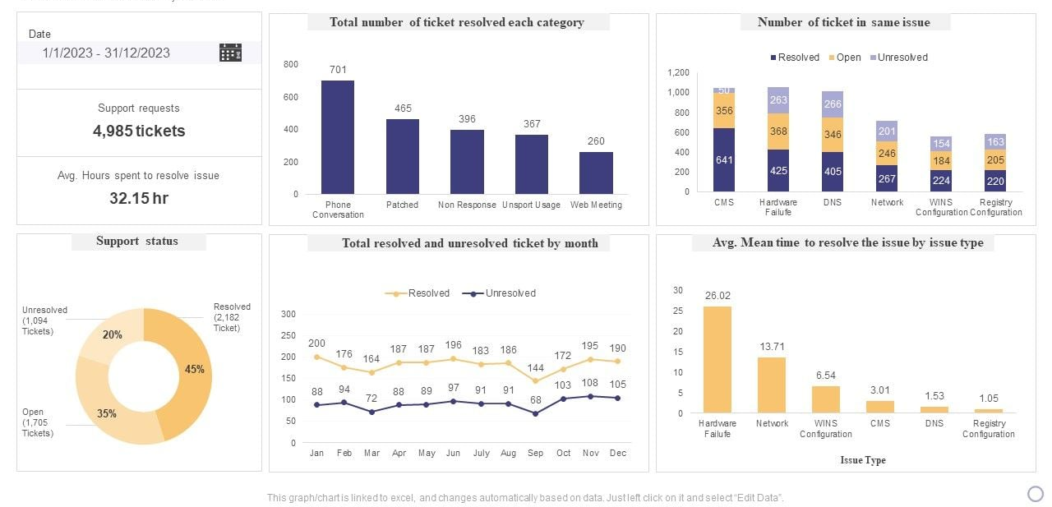
RESULT

Slide 10
CONCLUSION
In conclusion, air ticket analysis serves as a vital tool for airlines, travel agencies, and other stakeholders in the aviation industry to make informed decisions and optimize various aspects of their operations. Through the systematic collection, preprocessing, and analysis of data, valuable insights can be derived to enhance pricing strategies, route planning, customer segmentation, and overall business performance.

Slide 11
FUTURE SCOPE
Personalization and Customer Experience: Enhance personalization efforts by leveraging advanced analytics and machine learning to tailor travel recommendations, pricing options, and marketing messages based on individual preferences, behaviors, and demographics.
Real-Time Dynamic Pricing: Implement real-time dynamic pricing algorithms that consider factors such as demand fluctuations, competitor pricing, inventory levels, and customer segments to optimize ticket pricing and maximize revenue in a dynamic market environment.
Predictive Maintenance: Extend analysis beyond ticket sales to include predictive maintenance of aircraft and infrastructure. By analyzing maintenance data and historical performance metrics, airlines can optimize maintenance schedules, reduce downtime, and enhance operational efficiency.

Slide 12
REFERENCES
https://youtu.be/uOezVhTUIFQ?si=Do7DmHf7xAddOZdu
https://youtu.be/D_tIiYLWErI?si=Y1dIPMwKUaj1vH7D
https://www.altexsoft.com/blog/airline-ticketing/
https://en.m.wikipedia.org/wiki/Airline_ticket

Slide 13
THANK YOU

